Slide 1
Find Bugs
Code Review tools
It’s Source Code Analyzer

Slide 2
FindBugs Eclipse plugin
The FindBugs Eclipse plugin allows FindBugs to be used within the Eclipse IDE.

Slide 3
1. Requirements
To use the FindBugs Plugin for Eclipse, you need Eclipse 3.3 or later, and JRE/JDK 1.5 or later.

Slide 4
2. Installation - How to add find bug plugin to the eclispe ide??
1. Automatic
2. Manual

Slide 5
1. Automatic
Eclipse provides update sites that allow you to automatically install FindBugs into Eclipse and also query and install updates from Eclipse Installation software dashboard. There are three different update sites
FindBugs Eclipse update sites
http://findbugs.cs.umd.edu/eclipse/
Only provides official releases of FindBugs.
http://findbugs.cs.umd.edu/eclipse-candidate/
Provides official releases and release candidates of FindBugs.
http://findbugs.cs.umd.edu/eclipse-daily/
Provides the daily build of FindBugs. No testing other than that it compiles.

Slide 6
Install findbugs in to eclipse
1. Help
2. Install New software
3. Add site: http://findbugs.cs.umd.edu/eclipse
4. Select findbugs options in result
5. Next → Next → Finish

Slide 7
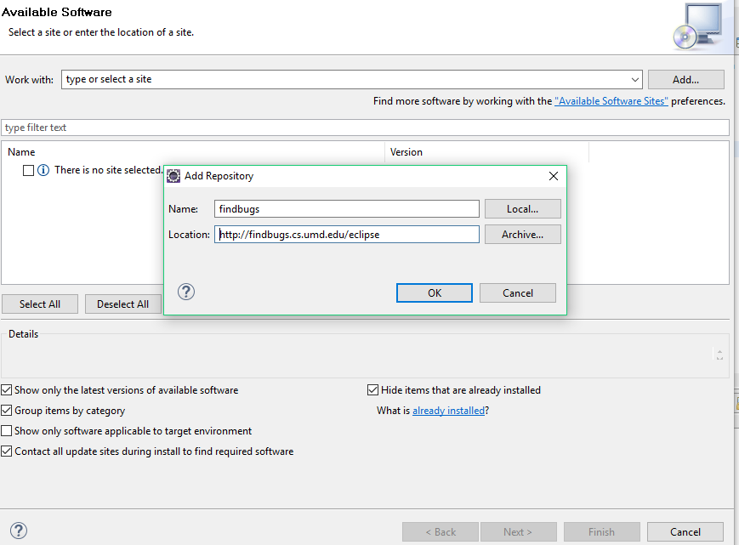

Slide 8
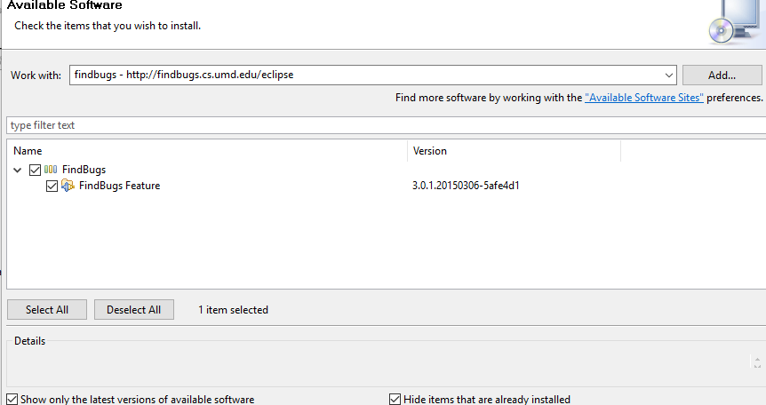

Slide 9
2.Manual
manually download the plugin from the following link:http://prdownloads.sourceforge.net/findbugs/edu.umd.cs.findbugs.plugin.eclipse_3.0.1.20150306.zip?download.
Extract it in Eclipse's "plugins" subdirectory. (So <eclipse_install_dir>/plugins/edu.umd.cs.findbugs.plugin.eclipse_3.0.1.20150306/findbugs.png should be the path to the FindBugslogo.)
Once the plugin is extracted, start Eclipse and choose Help → About Eclipse Platform → Plug-in Details. You should find a plugin called "FindBugs Plug-in" provided by "FindBugs Project".

Slide 10
Once the plugin is extracted, start Eclipse and choose Help → About Eclipse Platform → Plug-in Details. You should find a plugin called "FindBugs Plug-in" provided by "FindBugs Project".

Slide 11
Run Find bug
Write or take a java program
Right click → select find bugs → find bugs
Change the perspective to FindBugs
Bugs can be shown

Slide 12
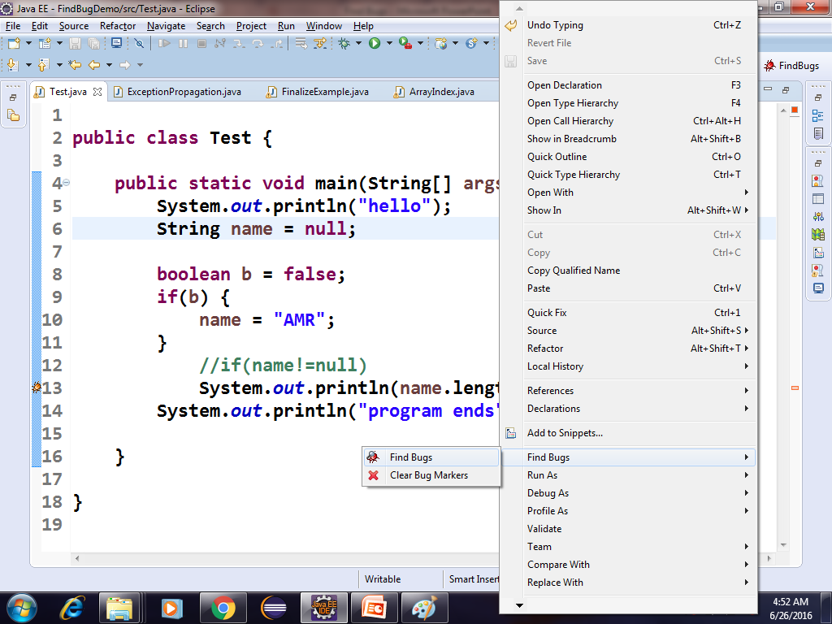

Slide 13
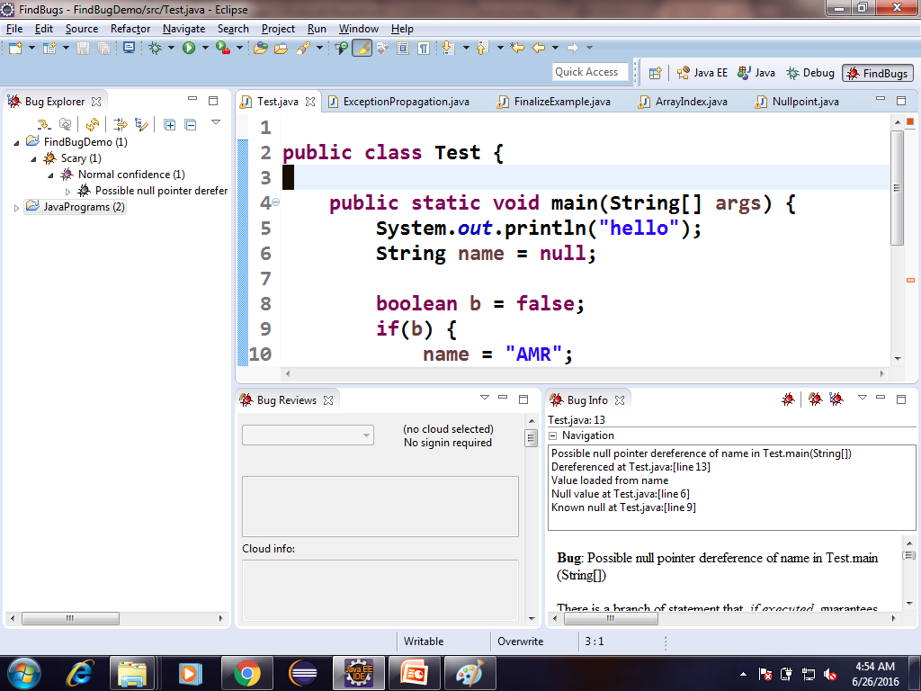
Findbugs Explorer

Slide 14
Run findbugs on java project
Right click on Project
Select findbugs → findbugs
Change the perspective to Findbugs
Bugs information of the project can be shown

Slide 15
Customize findbugs setttings
You may customize how FindBugs runs by opening the Properties dialog for a Java project, and choosing the "Findbugs" property page. Options you may choose include:
Enable or disable the "Run FindBugs Automatically" checkbox. When enabled, FindBugs will run every time you modify a Java class within the project.
Choose minimum warning priority and enabled bug categories. These options will choose which warnings are shown. For example, if you select the "Medium" warning priority, only Medium and High priority warnings will be shown. Similarly, if you uncheck the "Style" checkbox, no warnings in the Style category will be displayed.
Select detectors. The table allows you to select which detectors you want to enable for your project.

